Slide 1
REQUIREMENT GATHERING
BY GROUP 21
CEF440: MOBILE PROGRAMMING
SUPERVISOR: DR. NKEMENI VALERY

Slide 2
INTRODUCTION
Mobile based archival and retrieval of missing objects via image matching

Slide 3
REQUIREMENT GATHERING

Slide 4

Figure 1: Steps of requirement gathering

Slide 5
DOCUMENT ANALYSIS
System limitations
Stakeholder’s needs and expectations
Image matching technologies

Slide 6
STAKEHOLDER’S NEEDS AND EXPECTATIONS
User friendly interface
Accuracy of image matching
Speed
Privacy and security
Accessibility
Notification and updates
Support and help

Slide 7
IMAGE MATCHING TECHNOLOGIES
Feature based matching
Hashing Technique
Template matching
Histogram comparism

Slide 8
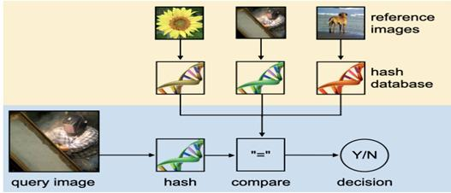
Figure 3: Overview of image hashing

Slide 9
ZS
SYSTEM REQUIREMENTS
Functional requirements
Non-functional requirements

Slide 10
and
FUNCTIONAL REQUIREMENTS
Registration and authentication
Image upload and storage
Image matching
User notification
User interaction
Reporting and management

Slide 11
NON-FUNCTIONAL REQUIREMENTS
Performance
Scalability
Security
Usability
Reliability
Compatability

Slide 12
CONCLUSION.
THANK YOU

